Slide 1
Artificial Intelligence
Recap: History & Recursion

Slide 2
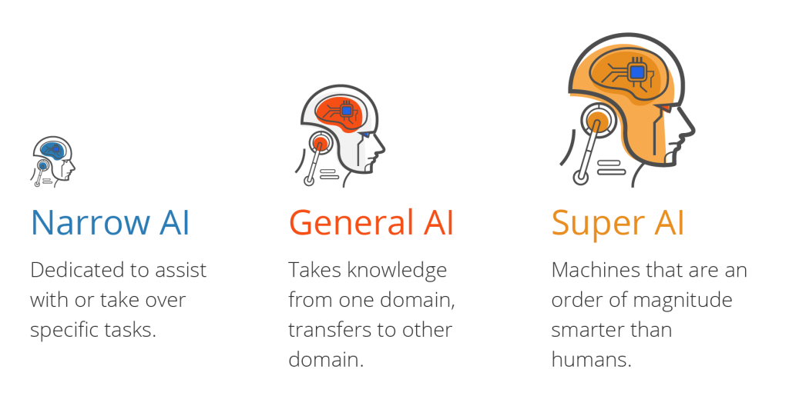
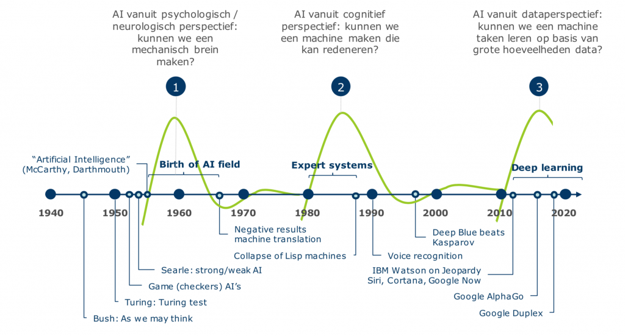
Recap – History, Weak-Strong AI

Slide 3
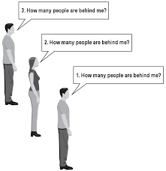
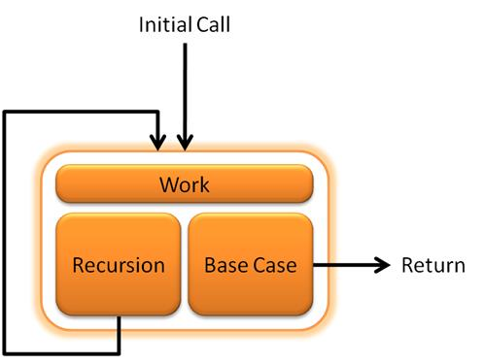
Recap – Recursion

Slide 4
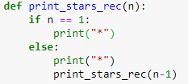
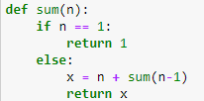
Recap – Recursion

Slide 5
Artificial Intelligence
Graph
‘a very versatile datastructure’

Slide 6
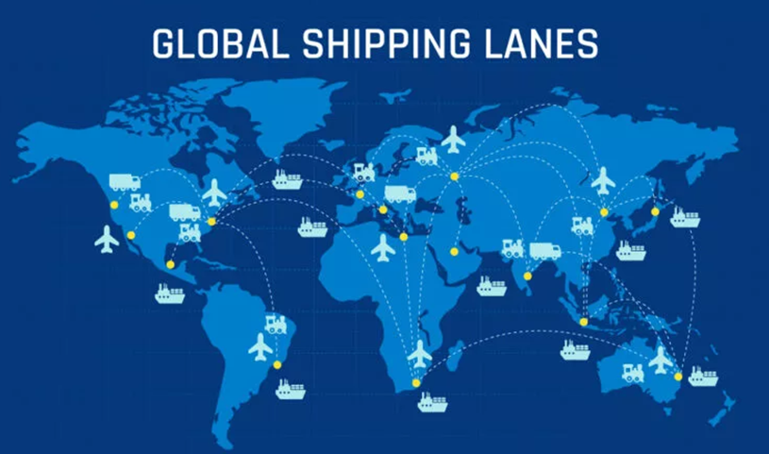
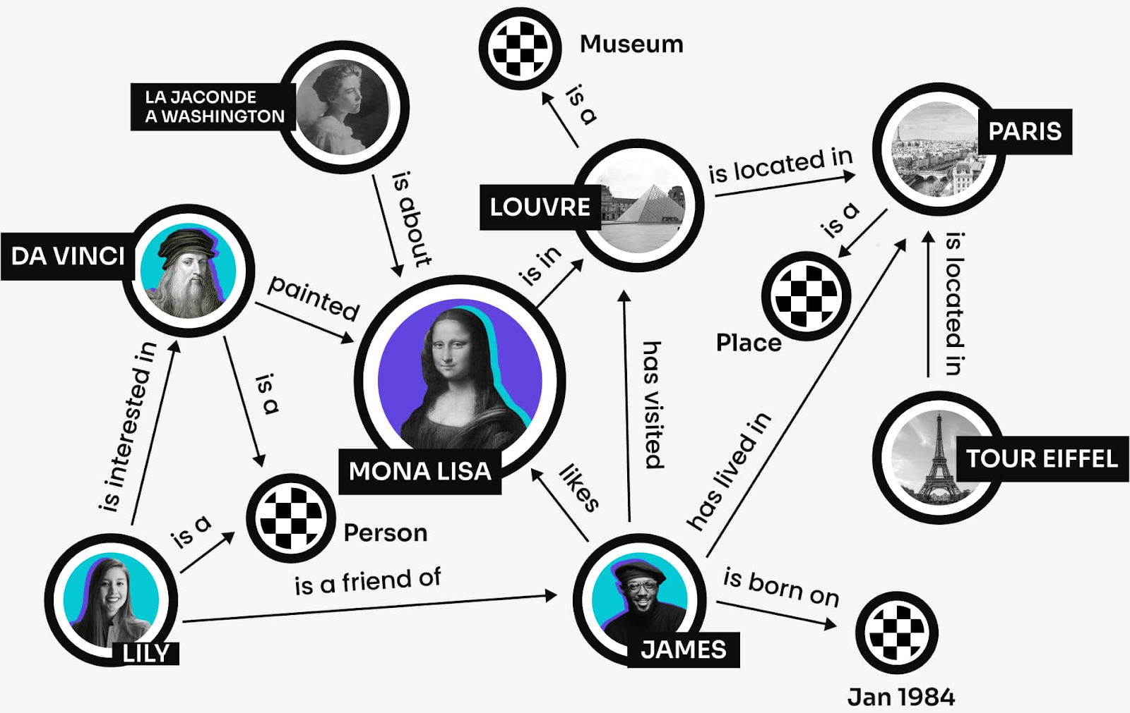
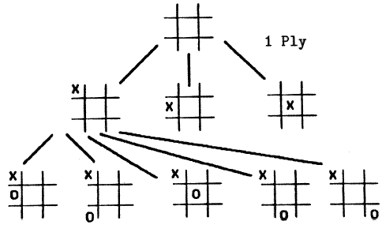
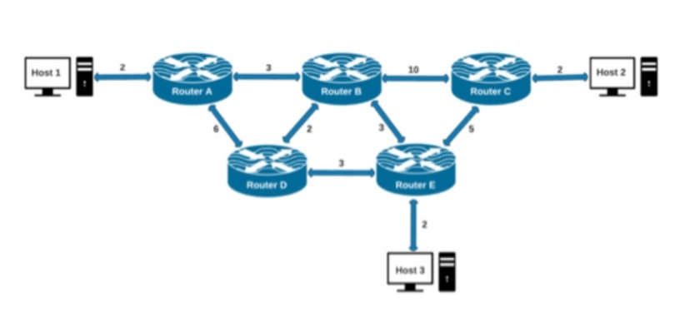

Knowledge represented as graph

Slide 7
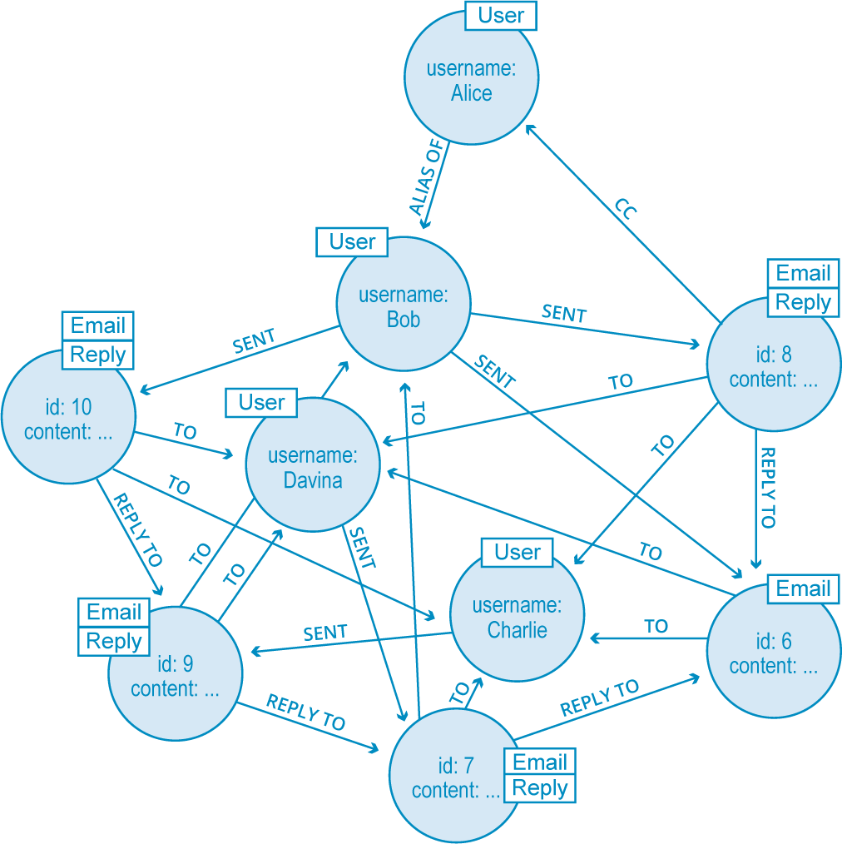
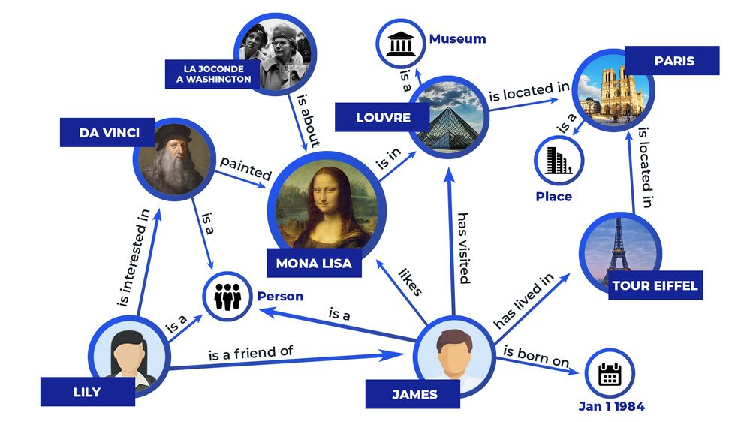
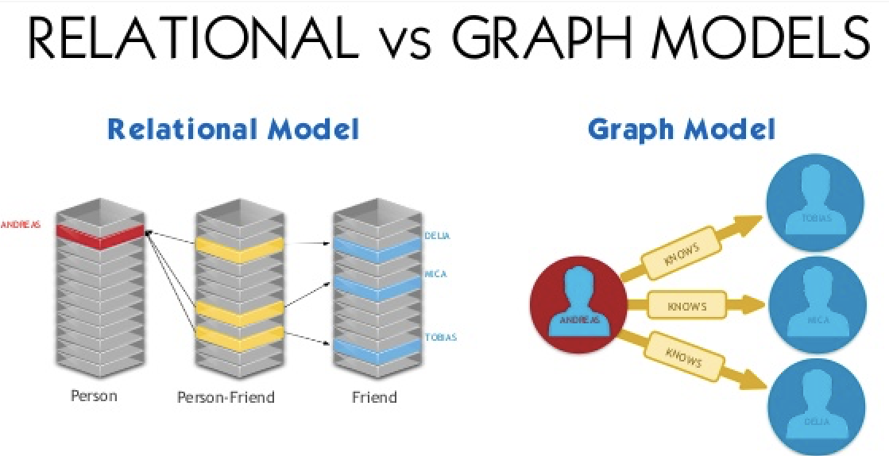
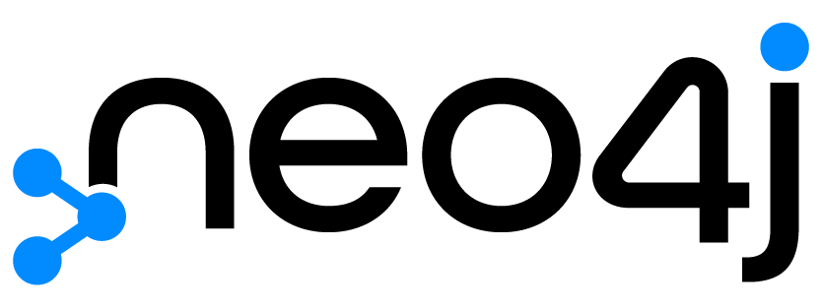
Sidenote Neo4j – Knowledge representation with graph DB

Slide 8
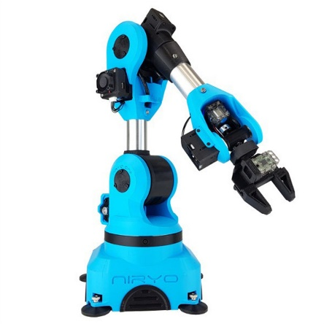
Graph Jargon
Node = vertex = ‘object’ with a certain state
All nodes in a graph are the same ‘object’, but in different states, different settings
Link between nodes = edges
How to ‘tweak’ your object to get to a different state
Lots of edges = dense graph
Few edges = sparse graph
A graph search from start to end node = series of actions you take to get to your start-state of the object to the goal-state = planning

Slide 9
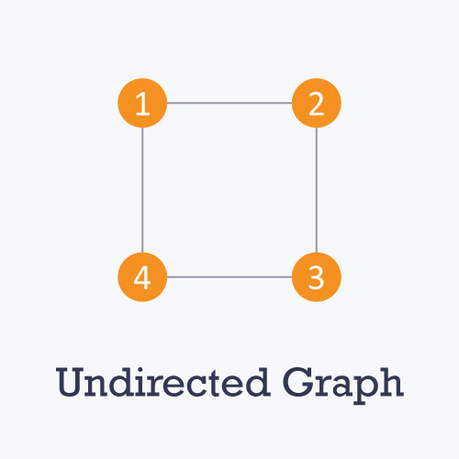
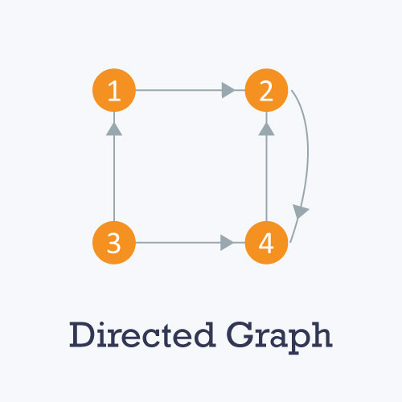
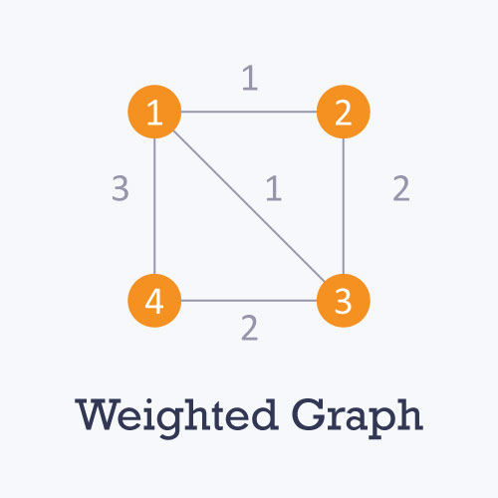
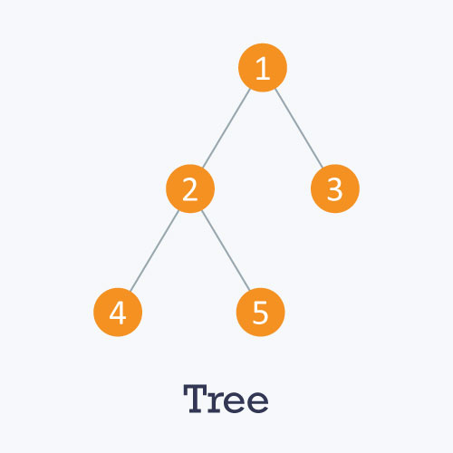
Types of Graphs

Slide 10
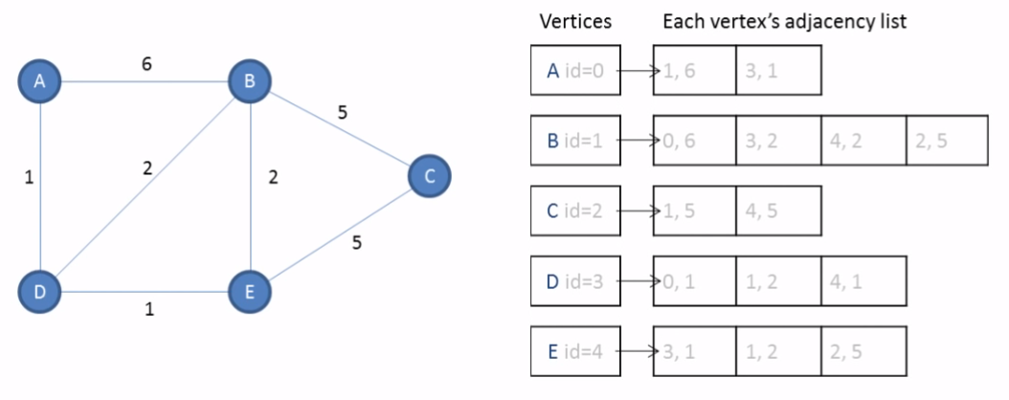
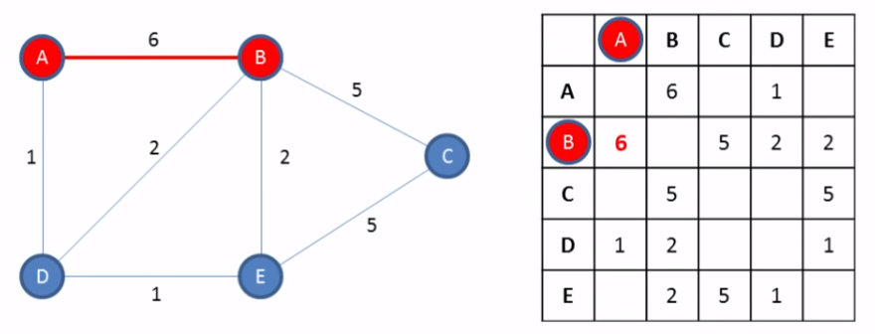
Implementation of graph datastructure
Different way to code / represent the world / problem
Adjacency list Adjacency matrix

Slide 11
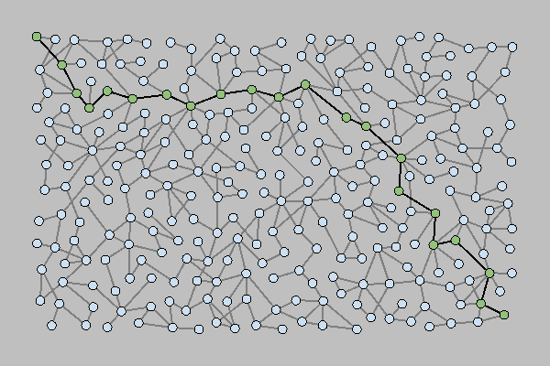
Artificial Intelligence
Graph Search
‘Path Finding’

Slide 12
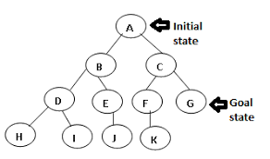
Searching Graph…from start to goal
Many, many algorithms…
Uninformed search
Depth first
Breadth first
Dijkstra (Shortest Path First)
Informed search
Having more ‘intel’ on goal states
A* (= Dijkstra optimization)

Slide 13
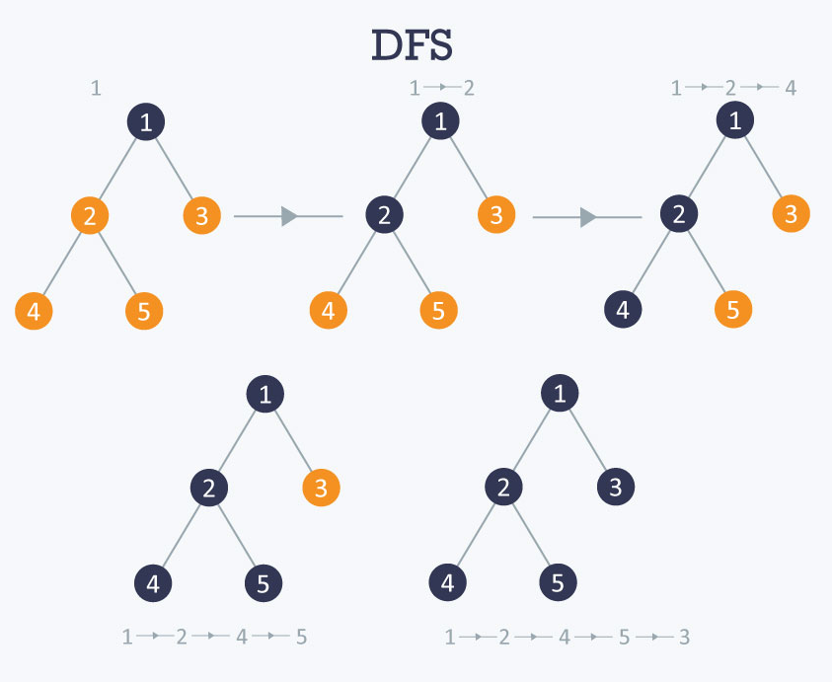
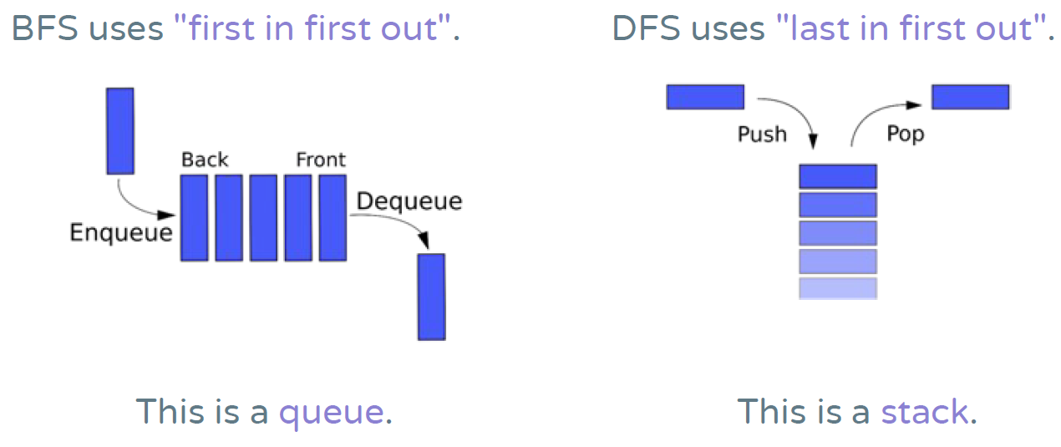
Uninformed: Dept-First Search (DFS)

Slide 14
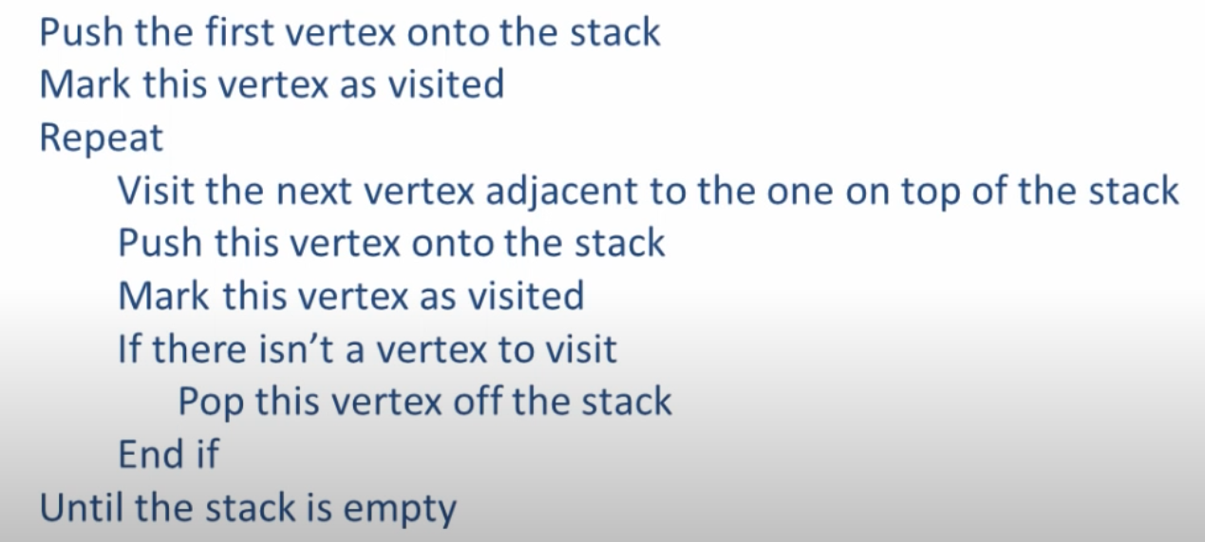
DFS - Algorithm
= Backtrack

Slide 15
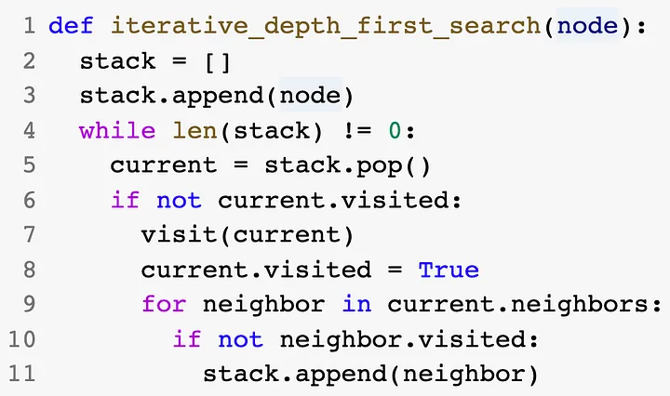
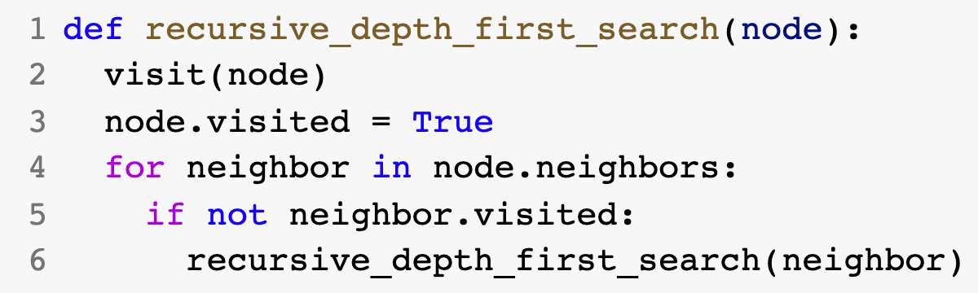
Link to recursion

Slide 16
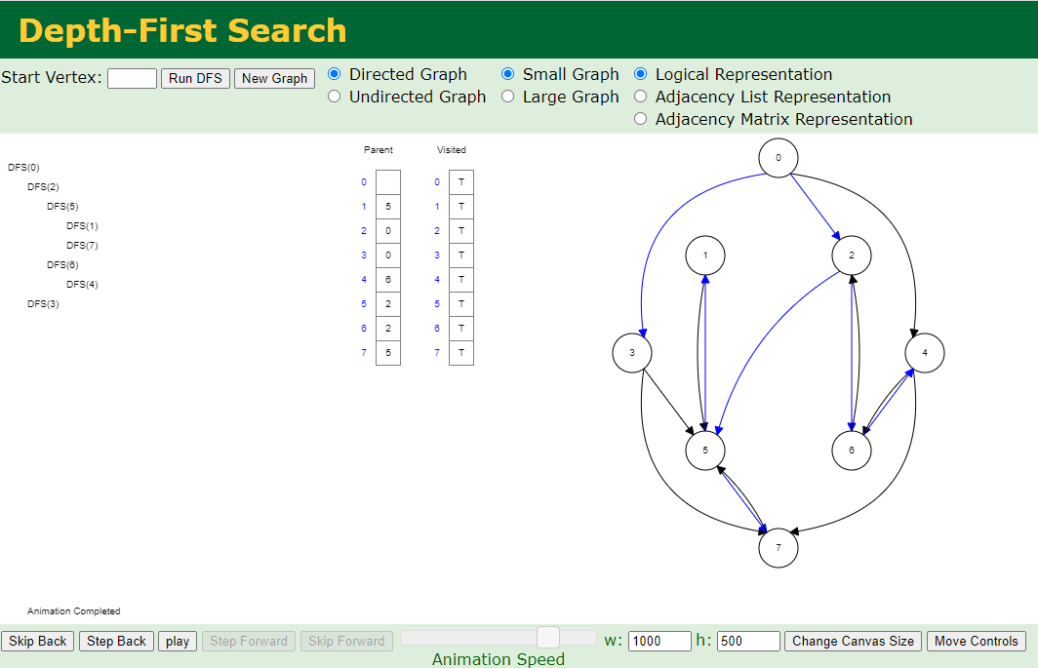
Let’s Try: https://www.cs.usfca.edu/~galles/visualization/DFS.html

Slide 17
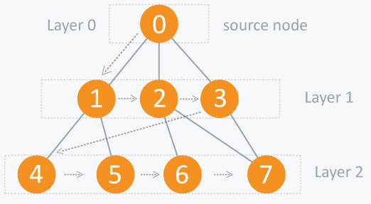
Uninformed: Breadth-First Search (BFS)

Slide 18
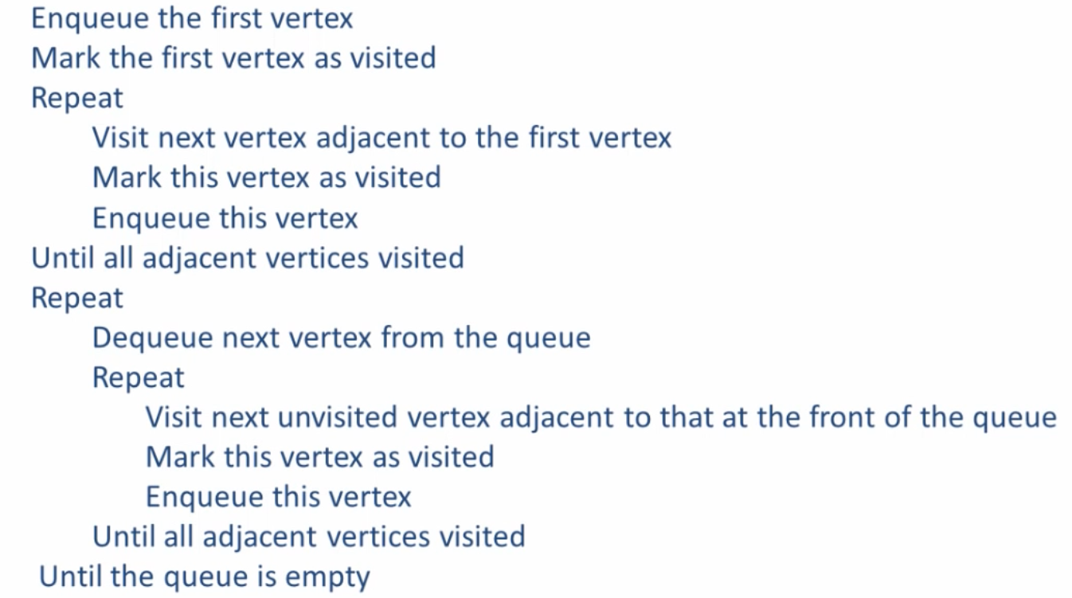
BFS - Algorithm
Hard to do recursively, since it uses a queue instead of a stack

Slide 19
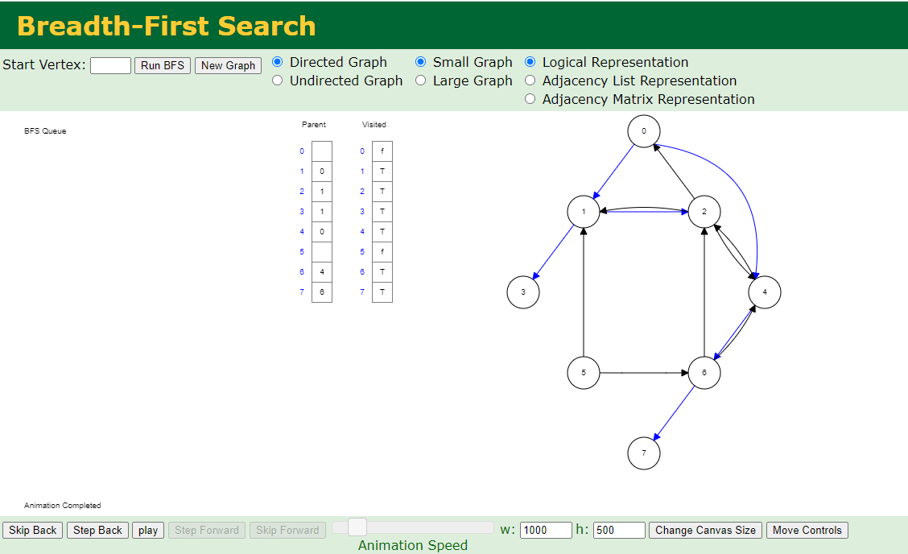
Let’s Try: https://www.cs.usfca.edu/~galles/visualization/BFS.html

Slide 20
Add ‘Intelligence’ (but still uninformed about goal node)
Dijkstra = add cost to the edges
Instead of using DFS/BFS to figure out next node, sort known nodes according to cost
At the start only start node is known = cost of 0
All other nodes have cost of ‘infinity’
Look at connected nodes -> update cost to get there -> sort by cost
Look at best node, and repeat recursively (look at connections, update, sort), maybe backtrack if stuck
= Greedy Search algorithm
(always take the next best node to look at,
without considering global optimal solutions)

Slide 21
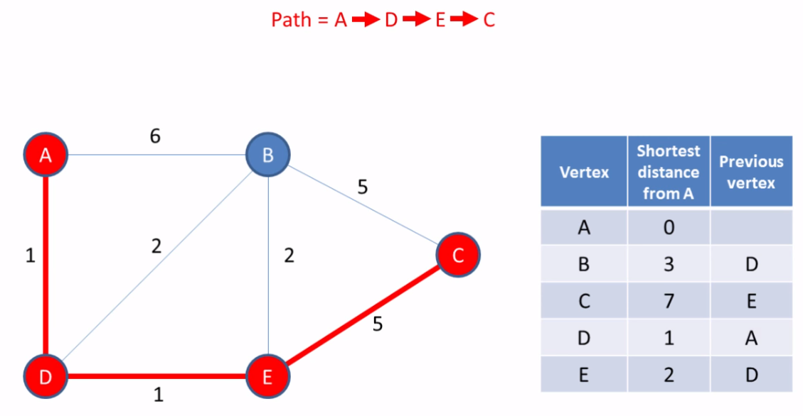
Dijkstra – Weighted Graph

Slide 22
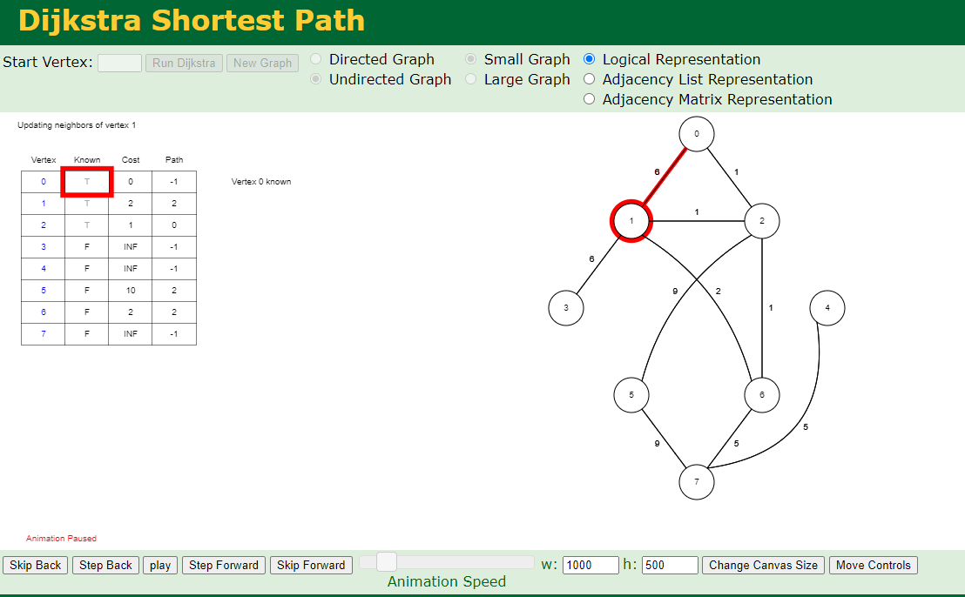
Let’s Try: https://www.cs.usfca.edu/~galles/visualization/Dijkstra.html

Slide 23
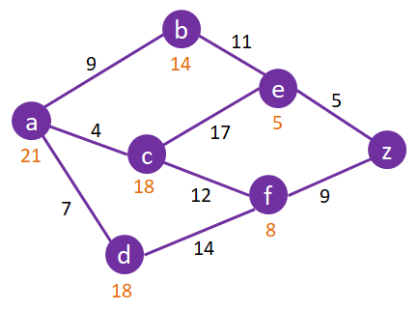
Informed Search (add intel about goal node) A* Algorithm
Dijkstra = Greedy!
Takes quick wins, no long-term best decisions.
We need more information to make a better decision, but it doesn’t need to be perfect, just a crude and fast ‘hint’= heuristic
A* = add extra cost to vertex
Each vertex (node) now also has a ‘cost’, adding to the total cost of traversing that edge
Smarter sorting!
Extra cost based on heuristic
‘quick and dirty way to add more knowledge of the world/problem into your solution. A quick way to add some level of goodness/badness to a node’
Distance measures (Manhattan distance, Euclidian distance), or amount of ‘likes’, or …

Slide 24
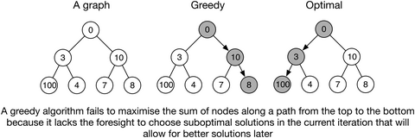
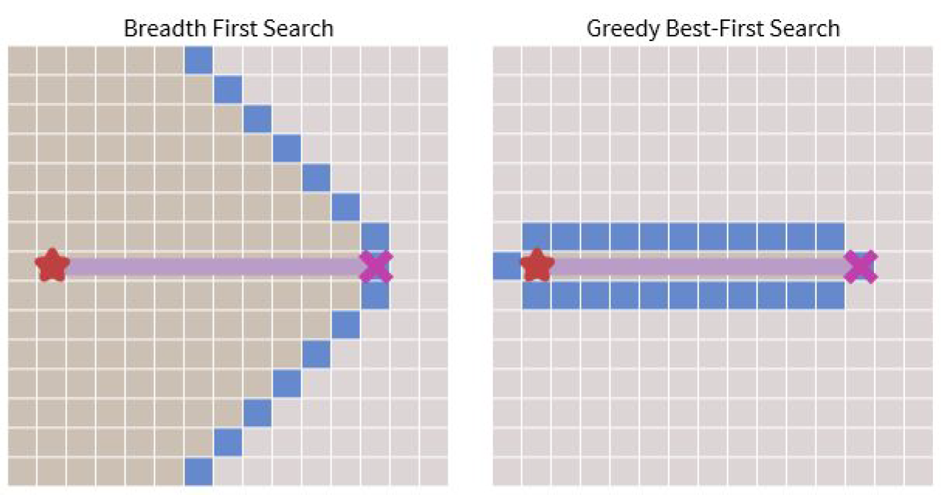
Greedy Algorithm

Slide 25
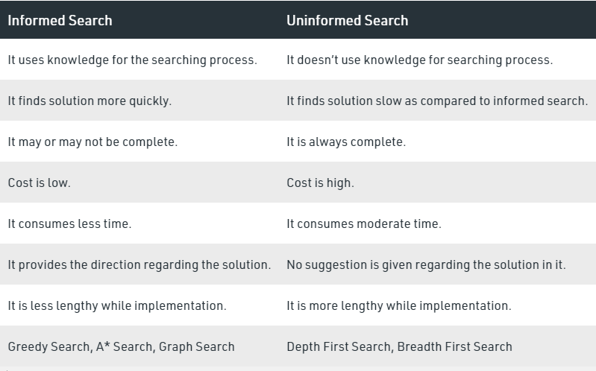

Slide 26
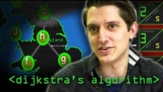
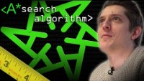
Extra: Computerphile

Slide 27
Artificial Intelligence
Constraint Satisfaction Problems
‘Employing the power of backtracking through a graph’

Slide 28
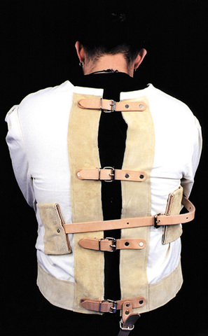
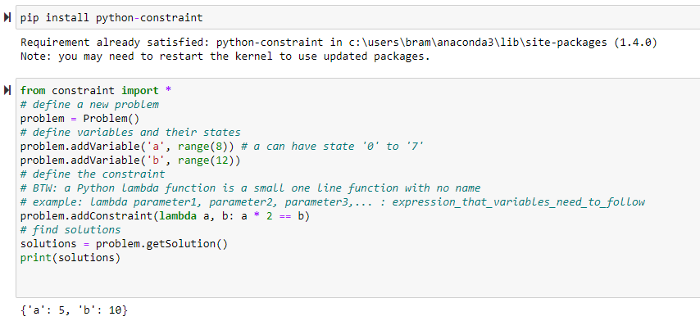
Constraint Satisfaction Problems
Using graphs to represent possible objects and their states
Define constraints: rules to obey in your planning

Slide 29
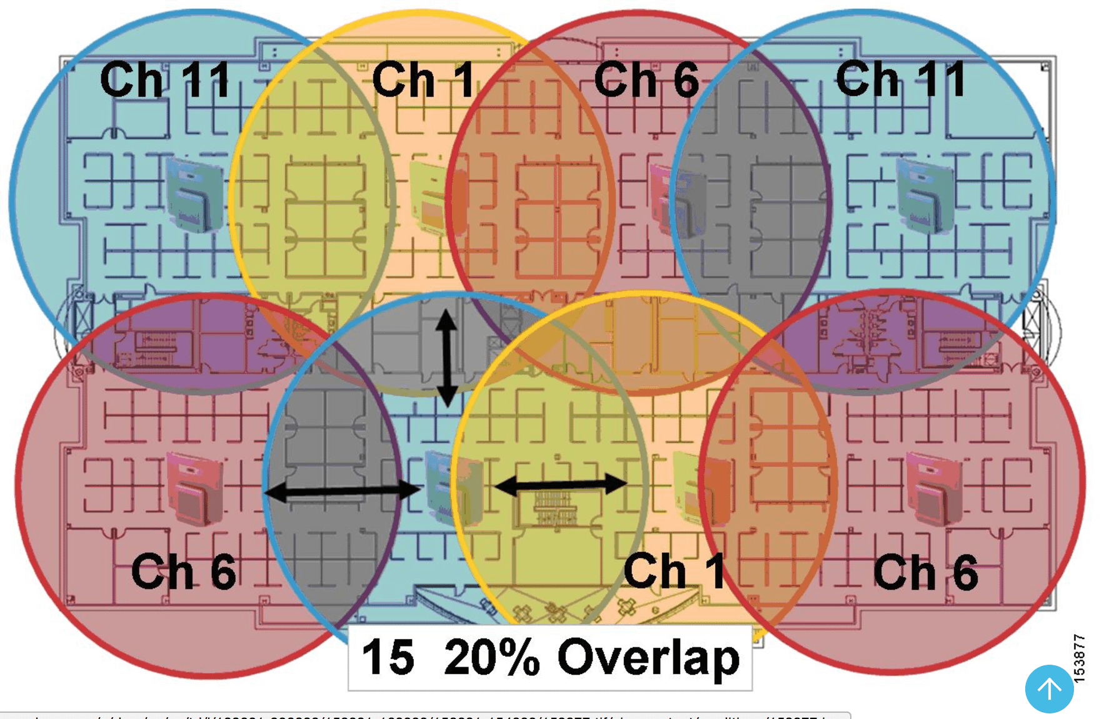
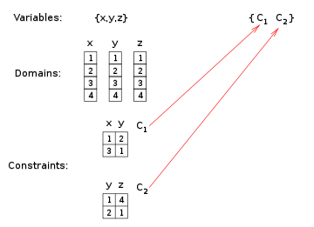
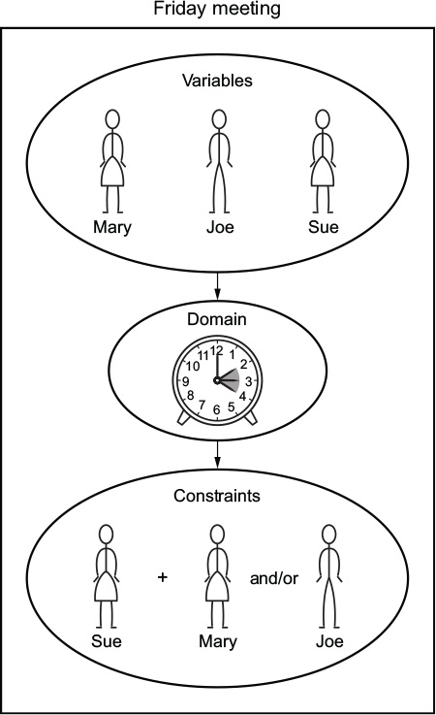
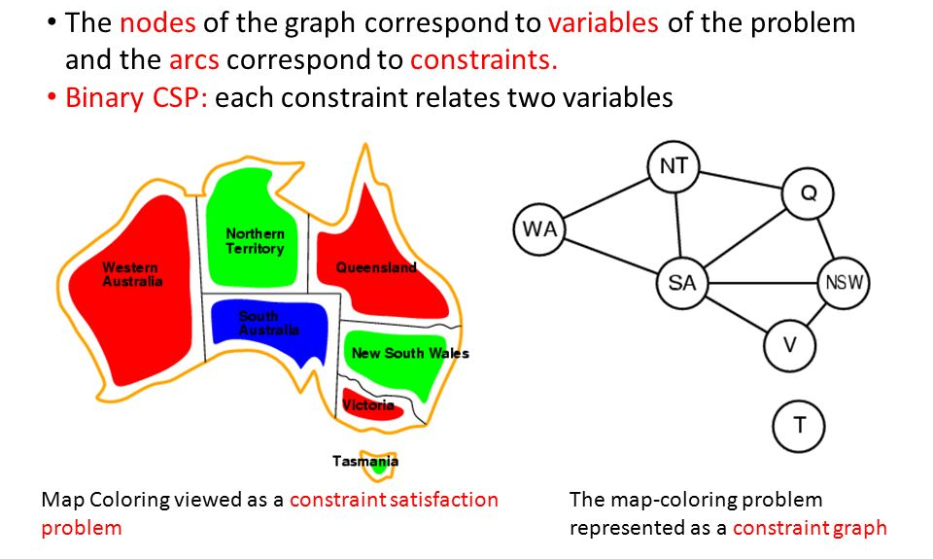
CSP Solving
Variables / Domains / Constraints Constraint Graphs

Slide 30
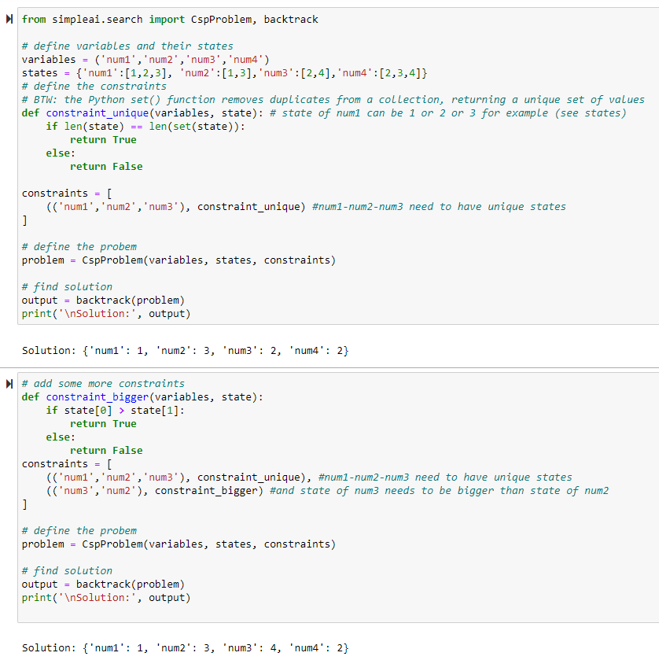

Slide 31
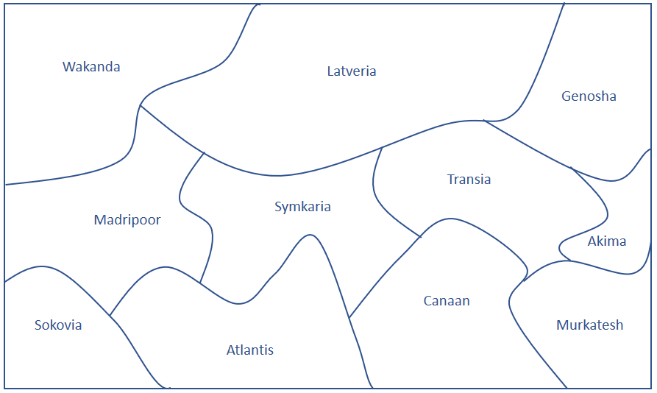
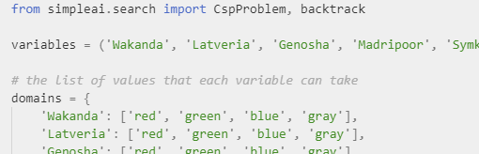
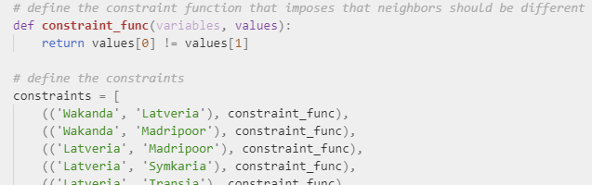

Region Coloring Problem

Slide 32




Some applications
Sudoku
Cryptarithmetic Puzzles
Maze

Slide 33


Crypto-Arithmetic

Slide 34


Extra: Computerphile

Slide 35



Over to you

